Slide 1
SeCURE DATA HIDING IN IMAGES USING STEGANOGRAPHY
CAPSTONE PROJECT
Presented By: Akshata Kirve
Student Name : Akshata Kirve
College Name : SIES Graduate School of Technology
Department : Computer Engineering

Slide 2
OUTLINE
Problem Statement
Technology used
Wow factor
End users
Result
Conclusion
Git-hub Link
Future scope

Slide 3
Problem Statement
With increasing cyber threats, protecting sensitive information during transmission is a major challenge. Traditional encryption methods can attract attention and be targeted for hacking. There is a need for a more discrete way to hide and send confidential messages without raising suspicion. This project aims to solve this problem by using steganography to hide messages inside images, ensuring secure and hidden communication.

Slide 4
Technology used
Programming language: Python
Image Processing Library: OpenCV
Graphical User Interface (GUI) Developemnt: Tkinter
Image handling Library: Pillow(PIL)
Platform: Visual Studio

Slide 5
Wow factors
A Tkinter-based interface makes encryption and decryption simple and accessible.
The passcode is stored within the image and verified automatically during decryption.
The Red channel stores the passcode, while the Green channel holds the message, enhancing security.
Uses PNG format to prevent data loss and maintain message integrity.
Works on Windows, Linux, and macOS, ensuring broad usability (Cross-Platform Compatibility).

Slide 6
End users
Cybersecurity Professionals – For secure communication and data protection.
Journalists & Activists – To safeguard sensitive information from surveillance.
Government & Intelligence Agencies – For covert data exchange and secure messaging.
Corporate Users – To protect confidential business information.
General Users – Anyone who wants to securely hide personal messages in images.

Slide 7
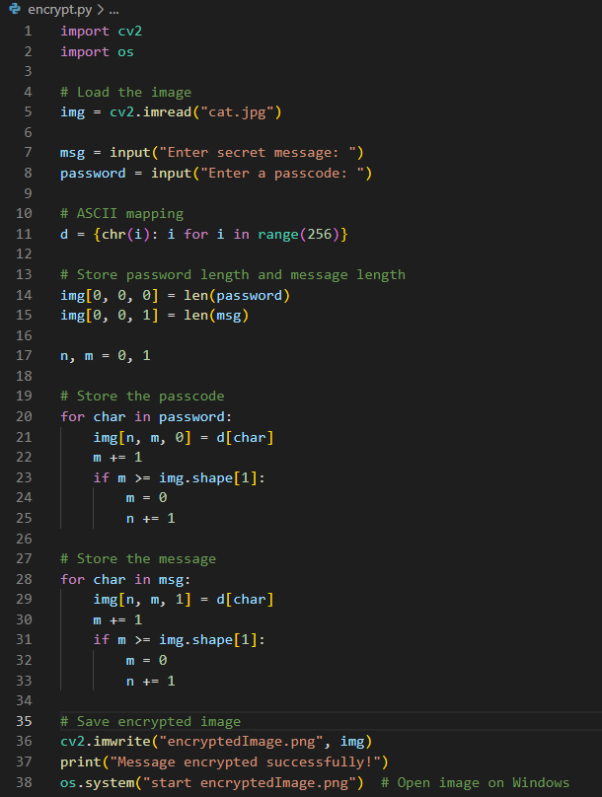
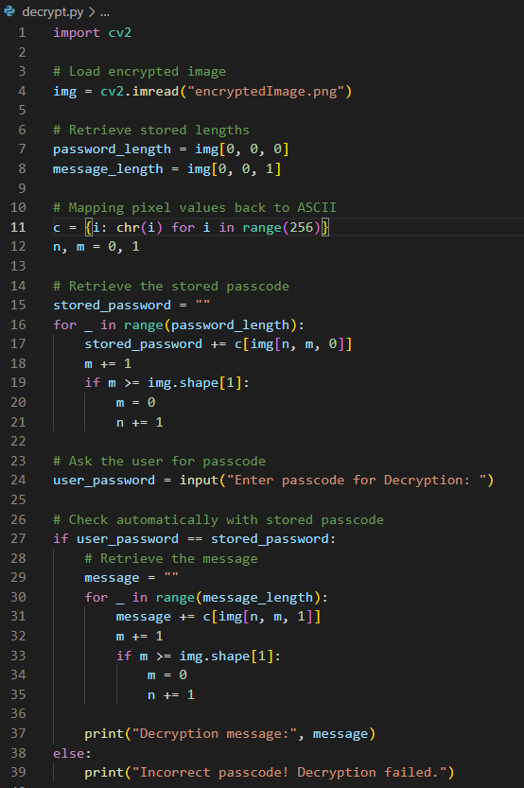
Results
Encryption Code
Decryption Code

Slide 8
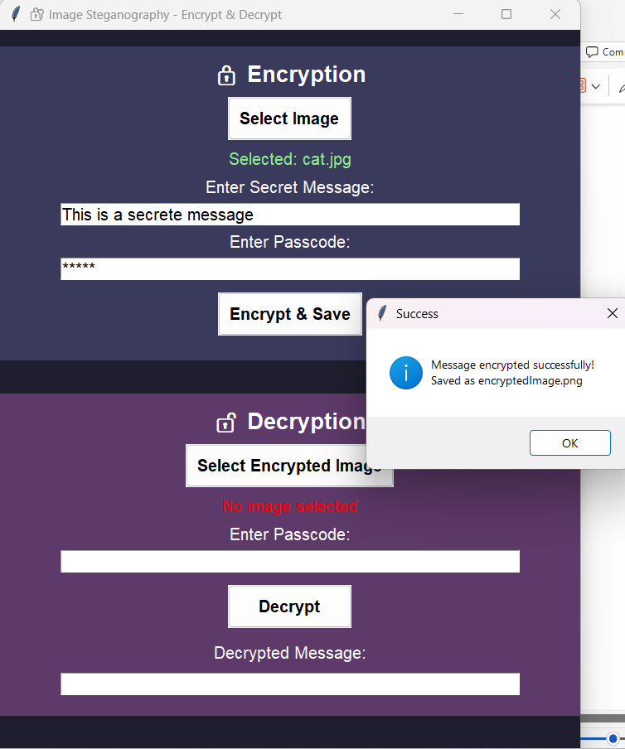
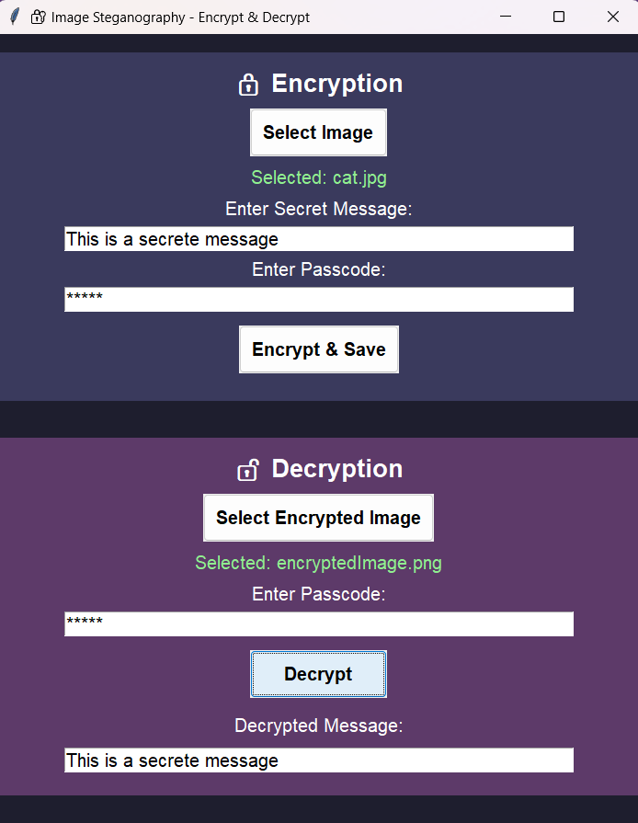
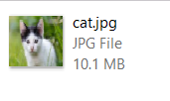

Results
Original Image
Encrypted Image
Encryption Process
Decryption Process

Slide 9
Conclusion
The project ensures secure and discreet data transmission using steganography.
Sensitive information is embedded within images to prevent unauthorized access.
A user-friendly GUI enhances ease of use while maintaining confidentiality.
It provides an efficient and reliable solution for covert communication.

Slide 10
GitHub Link
https://github.com/Akshatakirve38/Steganography.git

Slide 11
Future scope
Extend support for more image and multimedia file types.
Optimize data embedding to store larger messages securely.
Develop a mobile-friendly version for wider accessibility.
Use AI for automatic detection and prevention of steganalysis attacks.
Implement advanced encryption techniques for added protection.

Slide 12
THANK YOU

